Slide 1

Group 13
Freek Akkermans & Bas van Tol

Slide 2
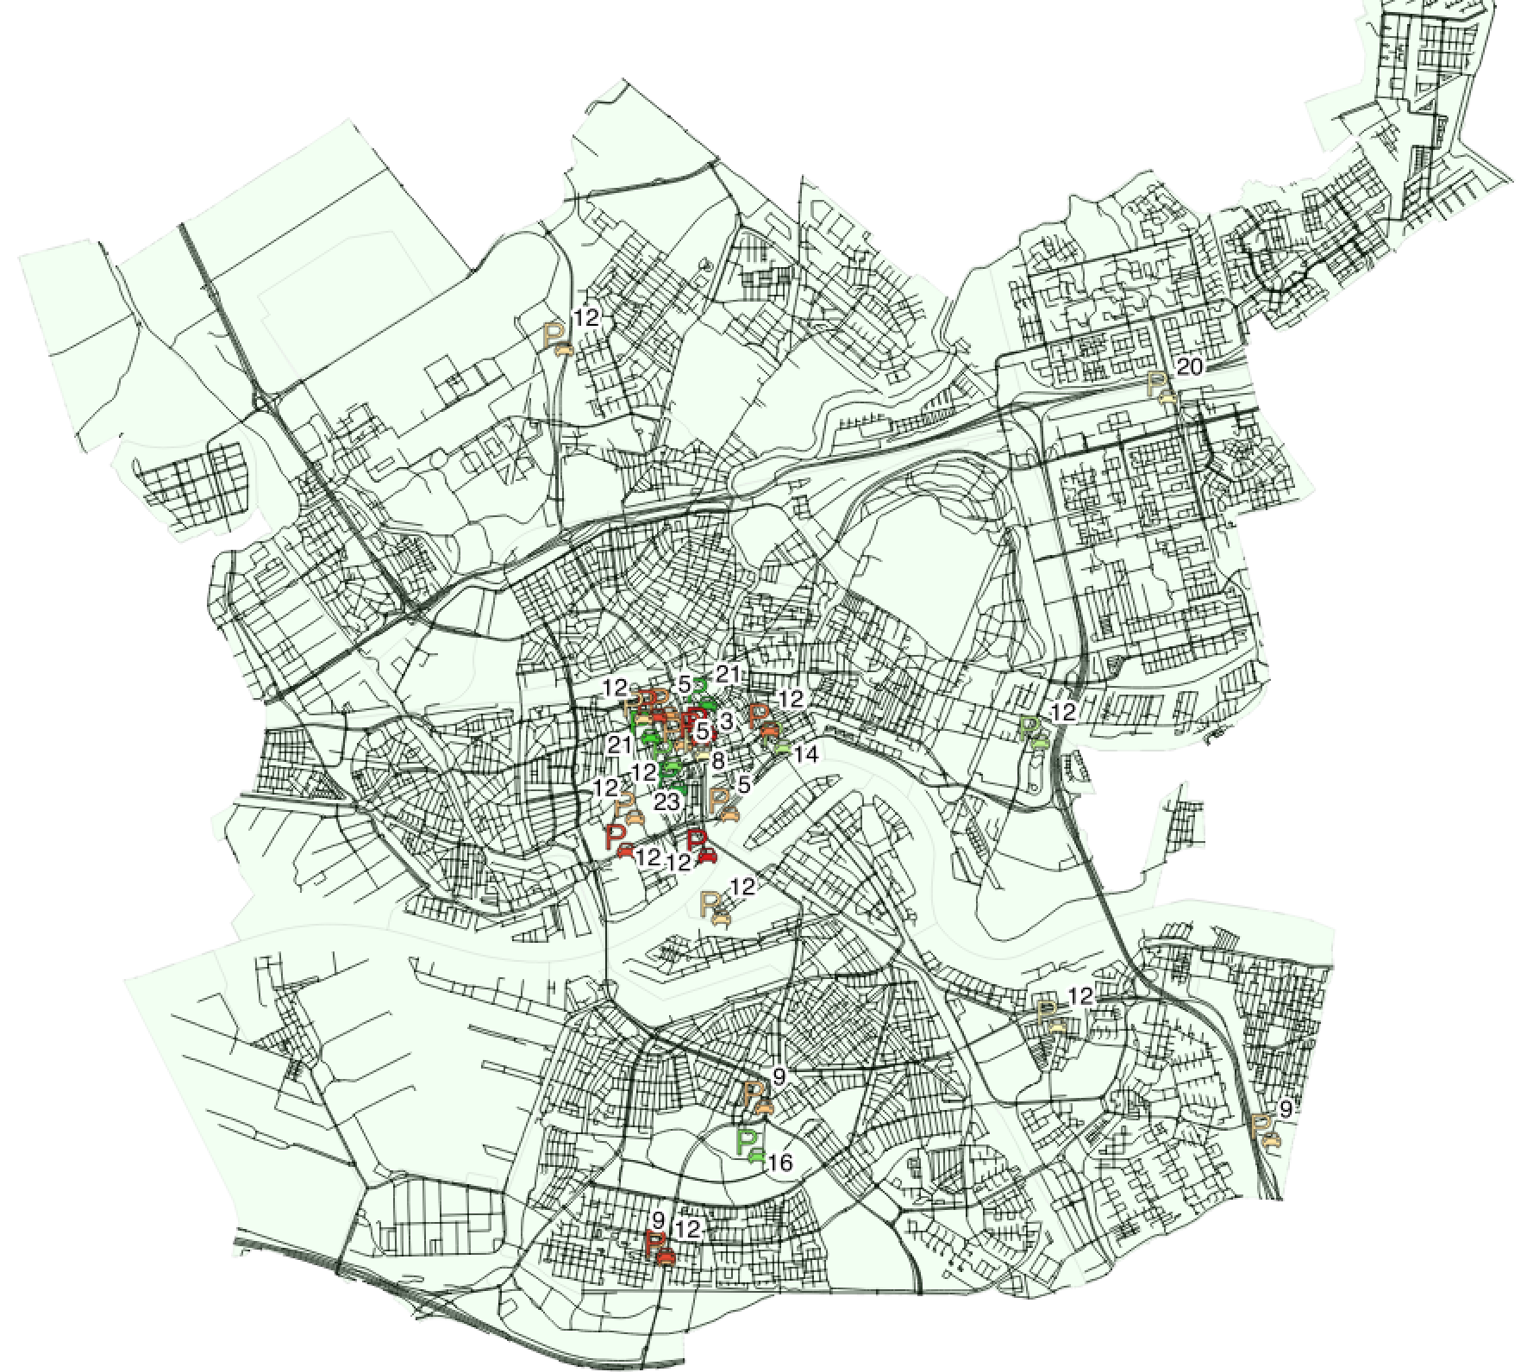
Scenario
General increase of Electric Vehicle (EV)owners
EV → Limited Range
Increase in demand for EV charging facilities
Charging infrastructure requires large investment
Optimizing these investments is highly desired!
SPARK data
App functionality focussed on EV user
Log user data
Use to find right locations and right quantities!

Slide 3
Outline
- User Interaction Component
- Data Component
- Analysis Component
- Visualization Component
- Demonstration

Slide 4
Use case
EV owner
Commuter between Amsterdam and Rotterdam
EV has limited range
Average EV can barely complete a back and forth trip from Amsterdam to Rotterdam
Easy access to information about charging locations desired
Spark shows all EV charging stations in Rotterdam
Icons and additional tags represent availability
Shows quickest route to the desired destination
Prompts user to evaluate the experience

Slide 5
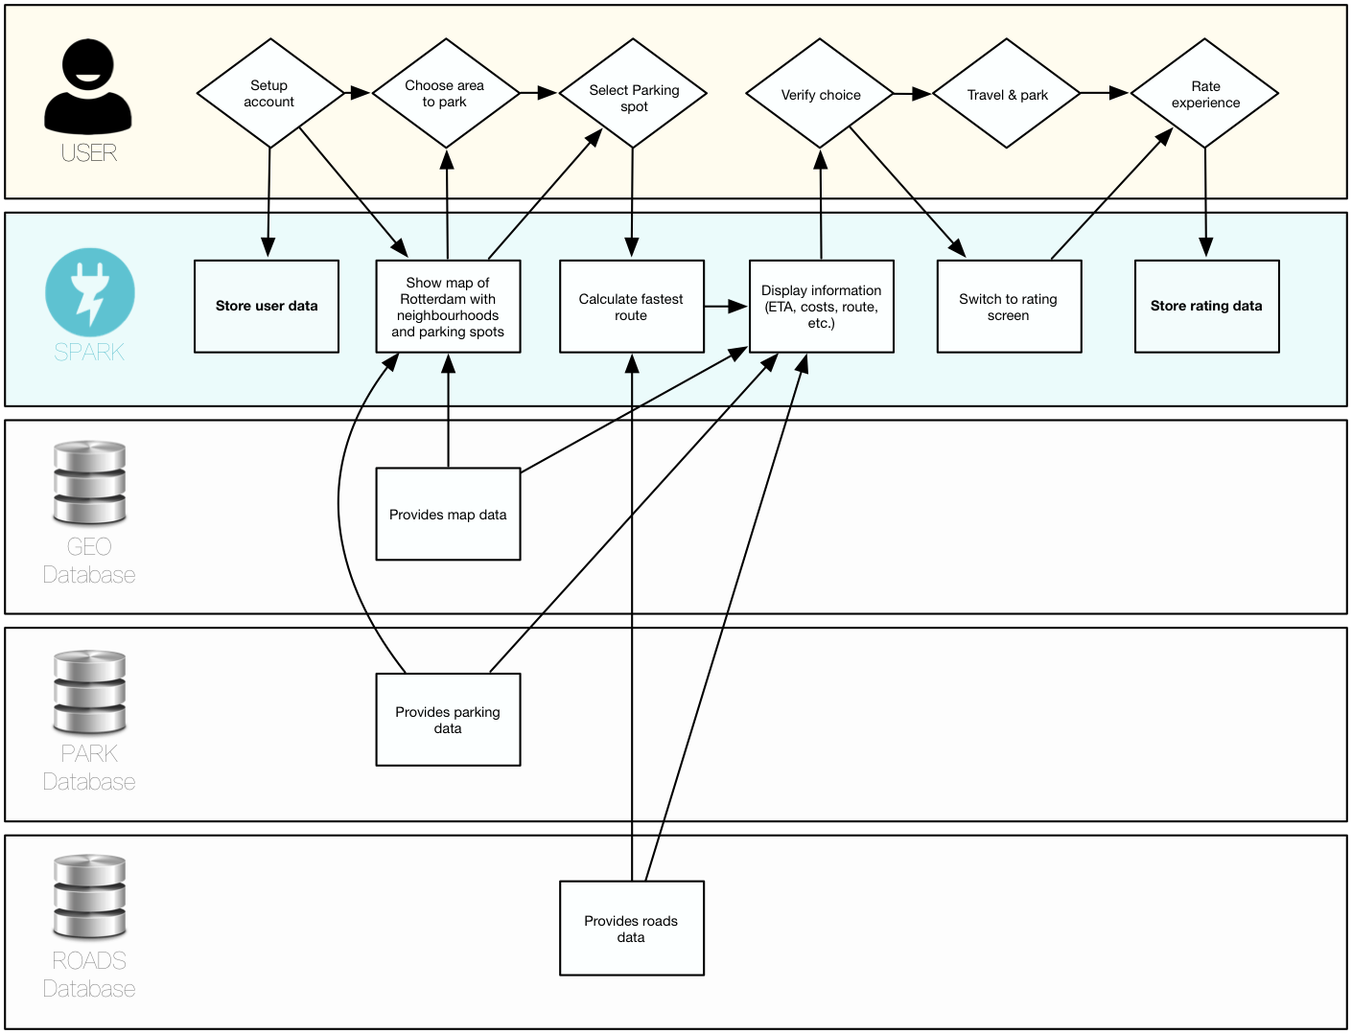
User Interaction Component
Notes:
Upon first usage.

Slide 6
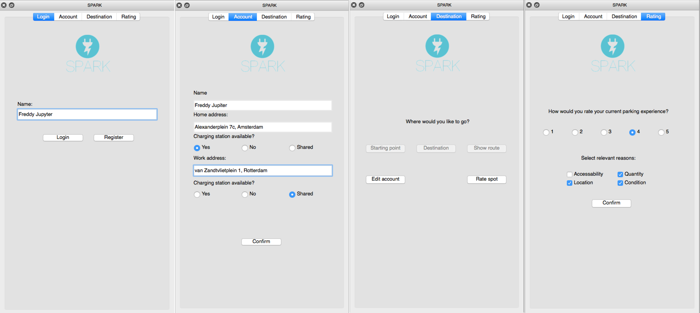
General User Interface
Notes:
User data is most valuable asset!
Fairly simple GUI concept allowed us to focus significantly on easy usability! Buttons activate and deactivate according to where the user finds himself in the process.

Slide 7
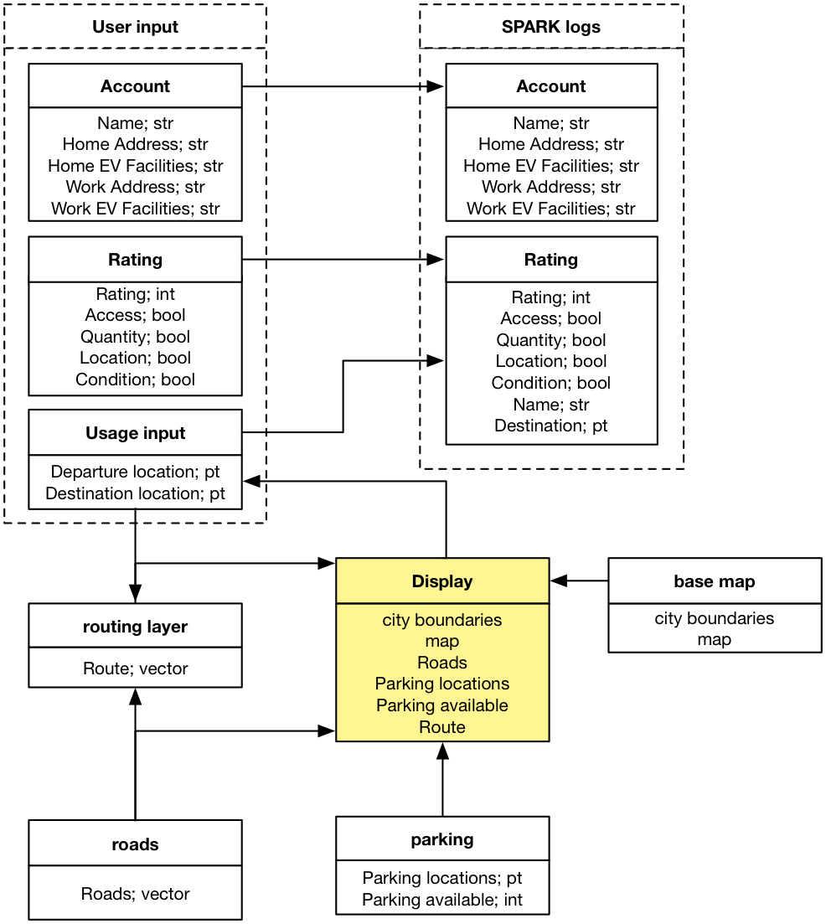
Data Component
- User as main data source
Base Map (Rotterdam Neighbourhoods)
Highlights functional area (Rotterdam)
Parking (Rotterdam parking)
Locations
Availability
Roads (Rotterdam roads)
Routing layer
SPARK logs

Slide 8
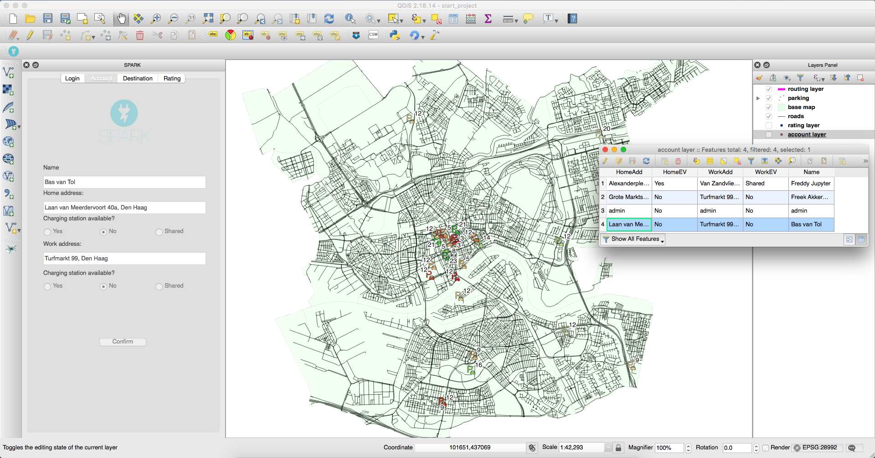
Data Component

Slide 9
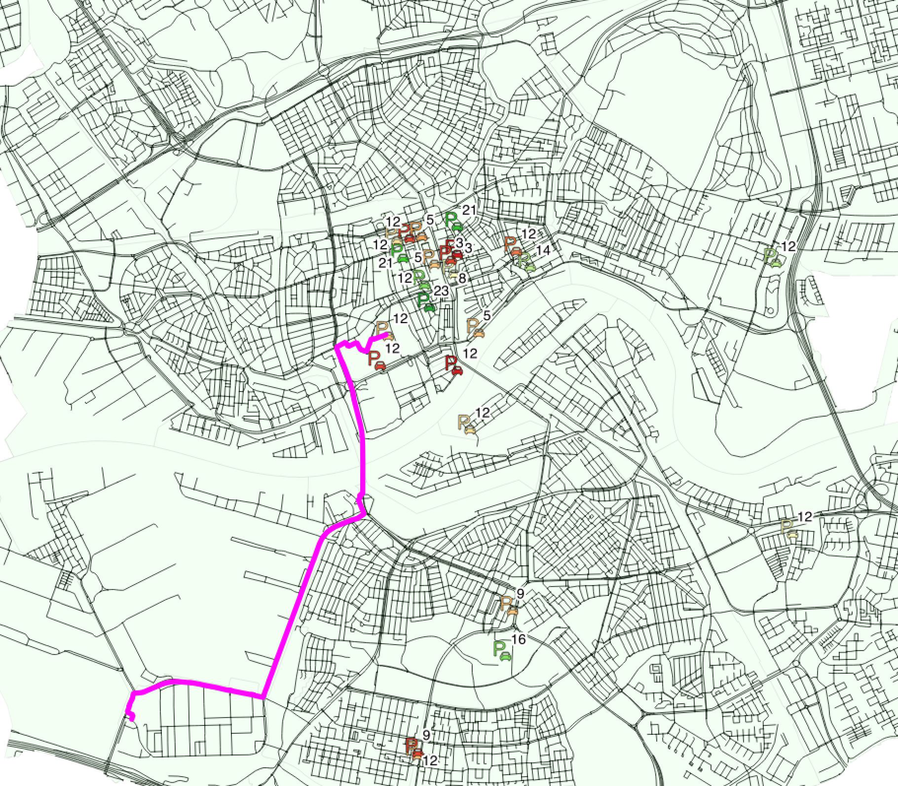
Analysis component
Input
- Roads, neighbourhoods and parking layers
Output
- User:
Locations & availability
Route: Dijkstras Algorithm
- Decision-makers
Account & Rating
Usage data: Geometry of chosen route

Slide 10
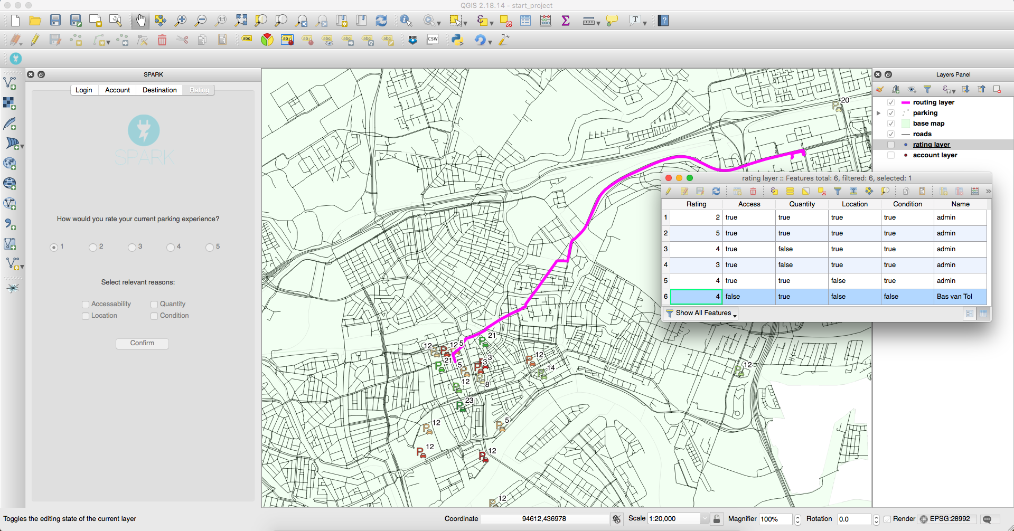
Visualization Component

Slide 11
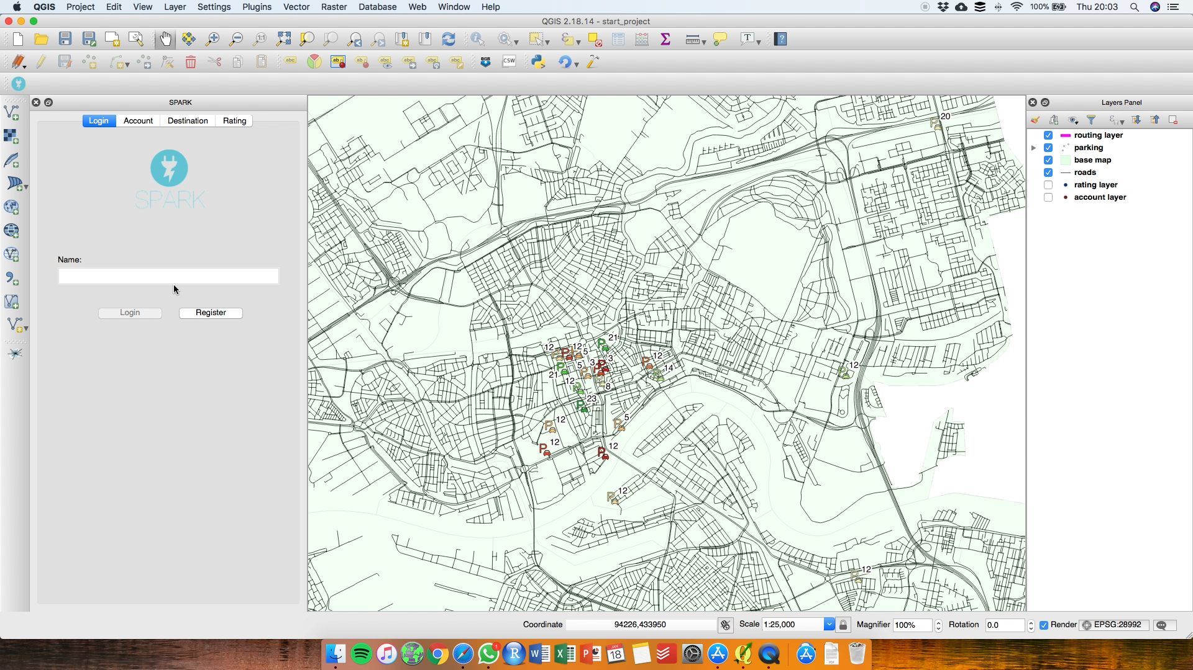

Slide 12
DISCUSSION

